Slide 1

Growing As Children of Light
Notes:
This graphic came from Jason Hardin. I am certain have I have used notes from Mark Copeland’s EO series, Randy Yerby, Aaron Fleenor and other in making these powerpoints. Further, images have been used from the internet that remain property of their owners. This can not be sold or used commercially. It can only be used for classroom (Bible class) purposes.

Slide 2
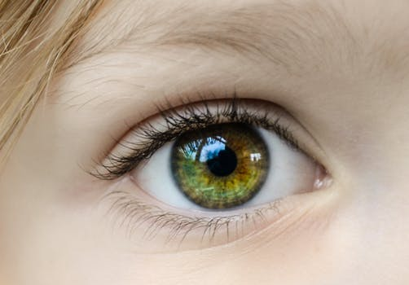

Eyeing Second Peter
Building On God’s Promises
Escaping the Corruption in the World
Partaking of the Divine Nature
Week 10: Love

Slide 3

Eyeing Second Peter
Weekly study plan:
Read 2 Peter once a week
Work on the memory verse by reading it carefully aloud at least eleven times this week
Any study on next weeks topic in the text from next week’s topic: Chapter 2 - Eyes Full of Adultery

Slide 4
Memory Passage: 2 Peter 1:3-4
According as his divine power hath given unto us all things that pertain unto life and godliness,
through the knowledge of him that hath called us to glory and virtue:
Whereby are given unto us exceeding great and precious promises:
that by these ye might be partakers of the divine nature,
having escaped the corruption that is in the world through lust.

Slide 5
Remembering Second Peter
Blindness and Myopia Control
Eyes Full of Adultery
Twinkling of an Eye
Holiness – Heresy – Hope
Cultivate Christian Character
Condemnation of false teachers
Confidence in Christ’s return
Read 10X, 10 Classes, Mechanism, Memory verse

Slide 6
Introduction: Myopia and Blindness Control
Growing in the knowledge of Jesus Christ requires developing a Christ-like character, partaking of the divine nature (holiness).
This requires all diligence to develop seven “graces”, in our lives, in conjunction with each other.
2 Peter 1:5-10 ⁵ And beside this, giving all diligence, add to your faith virtue; and to virtue knowledge;⁶ And to knowledge temperance; and to temperance patience; and to patience godliness;⁷ And to godliness brotherly kindness; and to brotherly kindness charity.⁸ For if these things be in you, and abound, they make you that ye shall neither be barren nor unfruitful in the knowledge of our Lord Jesus Christ.⁹ But he that lacketh these things is blind, and cannot see afar off, and hath forgotten that he was purged from his old sins.¹⁰ Wherefore the rather, brethren, give diligence to make your calling and election sure: for if ye do these things, ye shall never fall:

Slide 7

Introduction – Myopia and Blindness Control
Overview of 2 Peter and graces (Myopia Control)
Escaping corruption in the world through lust
Diligence
Build on “faith”.
Virtue or moral excellence
Knowledge
Self-Control
Patience
Godliness
Brotherly Kindness
“add” – epichoregeo
Love (charity)

Slide 8
Defining Love
Storge (family affection), Philos (Brotherly kindness), Agape (unconditional love, no matter what love), Eros (physical, passion, sexual)
Others
Love is not a theory but a practice
Active good will.
Love can be understood from the action it prompts.

Slide 9
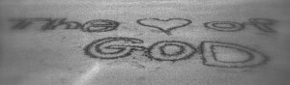
Defining Love: Attributes (1 Cor 13)
If I speak in the tongues of men and of angels, but have not love, I am a noisy gong or a clanging cymbal. 2 And if I have prophetic powers, and understand all mysteries and all knowledge, and if I have all faith, so as to remove mountains, but have not love, I am nothing. 3 If I give away all I have, and if I deliver up my body to be burned, but have not love, I gain nothing.4 Love is patient and kind; love does not envy or boast; it is not arrogant 5 or rude. It does not insist on its own way; it is not irritable or resentful; 6 it does not rejoice at wrongdoing, but rejoices with the truth. 7 Love bears all things, believes all things, hopes all things, endures all things. 8 Love never ends. As for prophecies, they will pass away; as for tongues, they will cease; as for knowledge, it will pass away. 9 For we know in part and we prophesy in part, 10 but when the perfect comes, the partial will pass away. 11 When I was a child, I spoke like a child, I thought like a child, I reasoned like a child. When I became a man, I gave up childish ways. 12 For now we see in a mirror dimly, but then face to face. Now I know in part; then I shall know fully, even as I have been fully known. 13 So now faith, hope, and love abide, these three; but the greatest of these is love.

Slide 10
Defining Love: Attributes (1 Cor 13)
Insert your name
______ is patient and kind; _____ does not envy or boast; _____ is not arrogant 5 or rude. ______ does not insist on its own way; _____ is not irritable or resentful; 6 _____ does not rejoice at wrongdoing, but rejoices with the truth. 7 _____ bears all things, believes all things, hopes all things, endures all things.

Slide 11
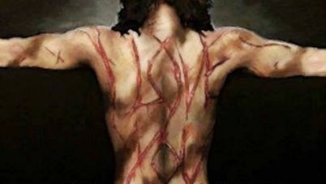
Romans 5:6-10 For while we were still weak, at the right time Christ died for the ungodly. 7 For one will scarcely die for a righteous person— though perhaps for a good person one would dare even to die—8 but God shows his love for us in that while we were still sinners, Christ died for us. 9 Since, therefore, we have now been justified by his blood, much more shall we be saved by him from the wrath of God. 10 For if while we were enemies we were reconciled to God by the death of his Son, much more, now that we are reconciled, shall we be saved by his life.

Slide 12

Love Is First
Mark 12:29-31 (ESV) 29 Jesus answered, “The most important [commandment] is, ‘Hear, O Israel: The Lord our God, the Lord is one. 30 And you shall love the Lord your God with all your heart and with all your soul and with all your mind and with all your strength.’ 31 The second is this: ‘You shall love your neighbor as yourself.’ There is no other commandment greater than these.”

Slide 13
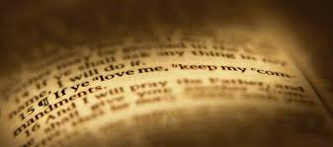
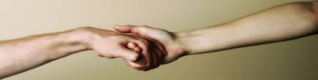
To joyfully practice God's love
Love is an action word: obedience and service.
Gary Chapman’s Love Languages: Gifts, quality time, words of affirmation, acts of service, and touch.
Romans 12:15 “Rejoice with those who rejoice, and weep with those who weep.”
1 John 3:16-19 Hereby perceive we the love of God, because he laid down his life for us: and we ought to lay down our lives for the brethren. But whoso hath this world's good, and seeth his brother have need, and shutteth up his bowels of compassion from him, how dwelleth the love of God in him? My little children, let us not love in word, neither in tongue; but in deed and in truth. And hereby we know that we are of the truth, and shall assure our hearts before him.

Slide 14

God’s Love and Loving Others
1 John 4:16-18 So we have come to know and to believe the love that God has for us. God is love, and whoever abides in love abides in God, and God abides in him. 17 By this is love perfected with us, so that we may have confidence for the day of judgment, because as he is so also are we in this world. 18 There is no fear in love, but perfect love casts out fear. For fear has to do with punishment, and whoever fears has not been perfected in love. 19 We love because he first loved us. 20 If anyone says, “I love God,” and hates his brother, he is a liar; for he who does not love his brother whom he has seen cannot love God whom he has not seen. 21 And this commandment we have from him: whoever loves God must also love his brother.

Slide 15
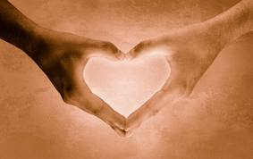
To joyfully practice God's love
God commands His children to love one another
1 John 4:7-11 Beloved, let us love one another: for love is of God; and every one that loveth is born of God, and knoweth God.He that loveth not knoweth not God; for God is love. In this was manifested the love of God toward us, because that God sent his only begotten Son into the world, that we might live through him. Herein is love, not that we loved God, but that he loved us, and sent his Son to be the propitiation for our sins. Beloved, if God so loved us, we ought also to love one another.

Slide 16
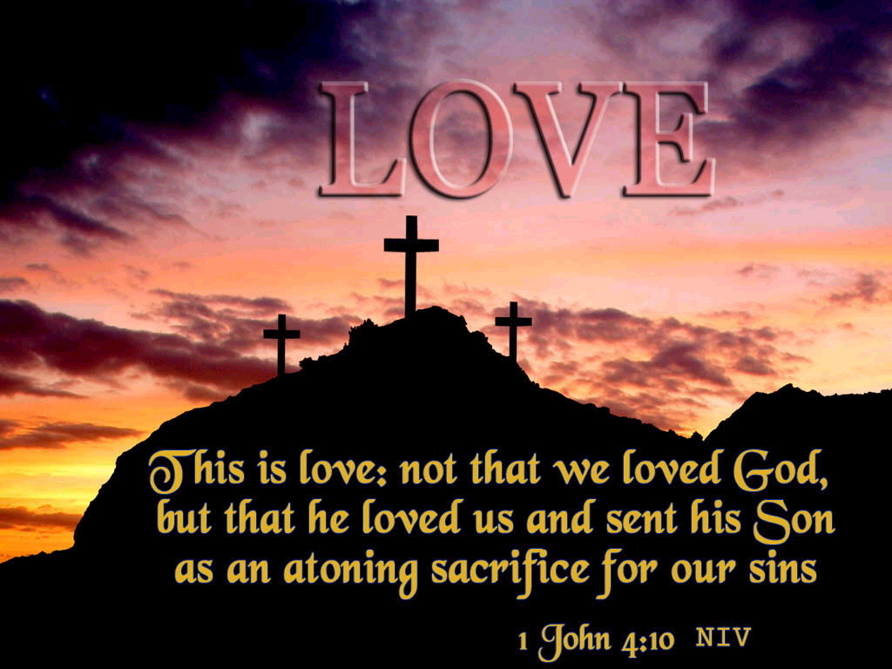

Slide 17
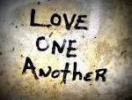
To joyfully practice God's love
Galatians 5:13-15 For, brethren, ye have been called unto liberty; only use not liberty for an occasion to the flesh, but by love serve one another. For all the law is fulfilled in one word, even in this; Thou shalt love thy neighbour as thyself. But if ye bite and devour one another, take heed that ye be not consumed one of another.

Slide 18
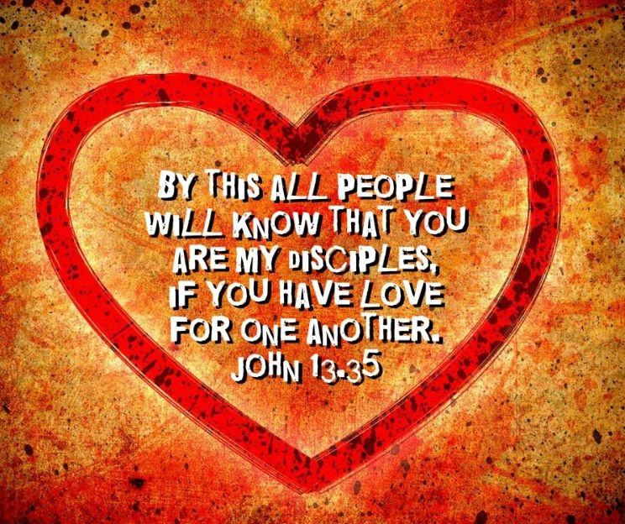
To joyfully practice God's love
Real evidence of discipleship is love for one another
John 13:34-35 34 A new commandment I give to you, that you love one another: just as I have loved you, you also are to love one another. 35 By this all people will know that you are my disciples, if you have love for one another.” (1 John 2:7-11)

Slide 19

To joyfully practice God's love
Love knits christians together
Colossians 2:2 that their hearts may be encouraged, being knit together in love, to reach all the riches of full assurance of understanding and the knowledge of God's mystery, which is Christ

Slide 20
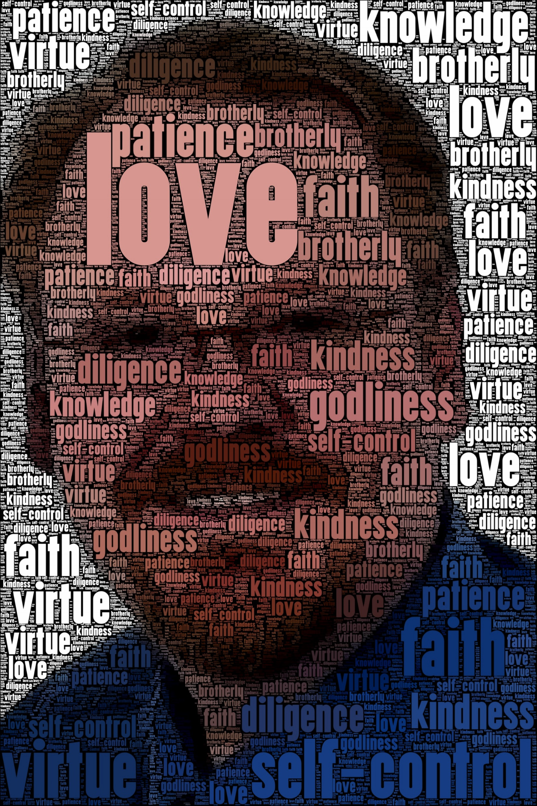
A Purpose Statement
If we had a camera that told us what we look like spiritually, this is who I want to be:
I best demonstrate love by serving others, in reflection of God’s love. God’s love is unconditional “agape” or “in spite of” love. His love is the greatest tool we have to do His work as it is reflected in our lives – pure, sincere, unpretentious, heartfelt, sacrificial, joyous to serve, overflowing of love for all others. All my spiritual failures are when I fall short of reflecting His love. I must learn His love that He sent from the counsels of eternity toward all His children. As I seek to be holy, I must demonstrate this love.

Slide 21

Loving God Requires Obedience
John 14:15-24 “If you love me, you will keep my commandments. 16 And I will ask the Father, and he will give you another Helper, to be with you forever, 17 even the Spirit of truth, whom the world cannot receive, because it neither sees him nor knows him. You know him, for he dwells with you and will be in you.18 “I will not leave you as orphans; I will come to you. 19 Yet a little while and the world will see me no more, but you will see me. Because I live, you also will live. 20 In that day you will know that I am in my Father, and you in me, and I in you. 21 Whoever has my commandments and keeps them, he it is who loves me. And he who loves me will be loved by my Father, and I will love him and manifest myself to him.” 22 Judas (not Iscariot) said to him, “Lord, how is it that you will manifest yourself to us, and not to the world?” 23 Jesus answered him, “If anyone loves me, he will keep my word, and my Father will love him, and we will come to him and make our home with him. 24 Whoever does not love me does not keep my words. And the word that you hear is not mine but the Father's who sent me.

Slide 22
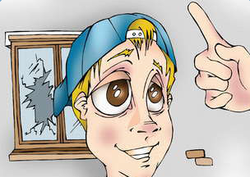
Chastening Indicates Love
Revelation 3:19 Those whom I love, I reprove and discipline, so be zealous and repent.
Love of the world prohibited
1 John 2:15-17 Do not love the world or the things in the world. If anyone loves the world, the love of the Father is not in him. 16 For all that is in the world—the desires of the flesh and the desires of the eyes and pride of life—is not from the Father but is from the world. 17 And the world is passing away along with its desires, but whoever does the will of God abides forever.

Slide 23

Summary
God is love, and he demonstrated His love by sacrificing His Son. We must love one another, and we must reflect God’s love in our lives by loving others. Love is an action of obedience, and serving others in righteousness and holiness. I resolve to joyfully practice God's love.
Convert this into daily/weekly activities.

Slide 24
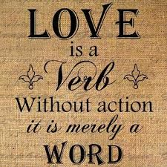

Slide 25
Love ...
John 21:15-19 When they had finished breakfast, Jesus said to Simon Peter, “Simon, son of John, do you love (agapaō) me more than these?” He said to him, “Yes, Lord; you know that I love (phileō) you.” He said to him, “Feed my lambs.” 16 He said to him a second time, “Simon, son of John, do you love (agapaō) me?” He said to him, “Yes, Lord; you know that I love (phileō) you.” He said to him, “Tend my sheep.” 17 He said to him the third time, “Simon, son of John, do you love (phileō) me?” Peter was grieved because he said to him the third time, “Do you love (phileō) me?” and he said to him, “Lord, you know everything; you know that I love (phileō) you.” Jesus said to him, “Feed my sheep. 18 Truly, truly, I say to you, when you were young, you used to dress yourself and walk wherever you wanted, but when you are old, you will stretch out your hands, and another will dress you and carry you where you do not want to go.” 19 (This he said to show by what kind of death he was to glorify God.) And after saying this he said to him, “Follow me.”
Notes:
We notice the word play involves different Greek words that is lost in English…. Why is this important?

Slide 26
How do the “graces” we studied prevent nearsightedness and blindness?

Slide 27
How do the “graces” we studied prevent nearsightedness and blindness?
1 John 1:7 But if we walk in the light, as he is in the light, we have fellowship with one another, and the blood of Jesus his Son cleanses us from all sin. (ESV)
2 Peter 1:4-9 by which he has granted to us his precious and very great promises, so that through them you may become partakers of the divine nature, having escaped from the corruption that is in the world because of sinful desire. ⁵ For this very reason, make every effort to supplement your faith with virtue, and virtue with knowledge, ⁶ and knowledge with self-control, and self-control with steadfastness, and steadfastness with godliness, ⁷ and godliness with brotherly affection, and brotherly affection with love. ⁸ For if these qualities are yours and are increasing, they keep you from being ineffective or unfruitful in the knowledge of our Lord Jesus Christ. ⁹ For whoever lacks these qualities is so nearsighted that he is blind, having forgotten that he was cleansed from his former sins

